Slide 1

1.2 Extracting Data
© London Academy of IT, www.londonacademyofit.co.uk

Slide 2
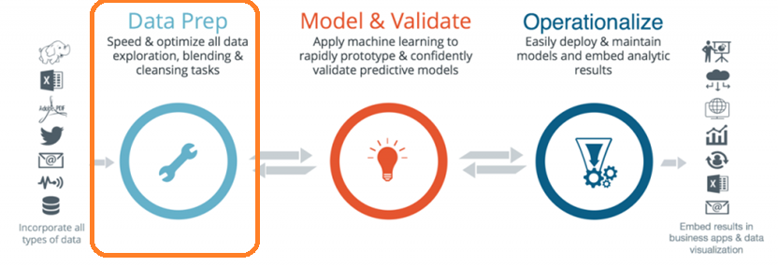
Data Science Project Cycle - Extracting Data

Slide 3
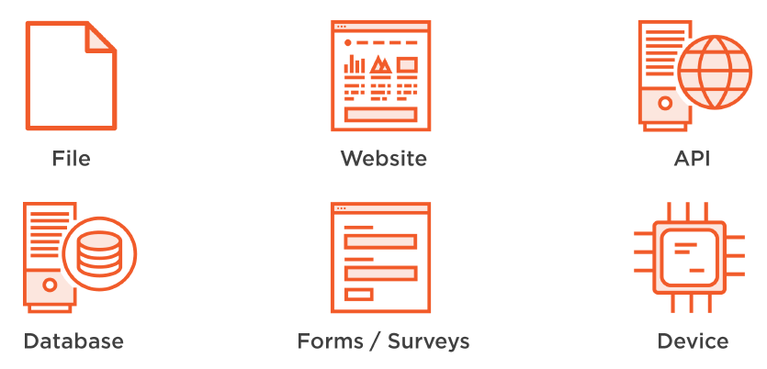
Data Source

Slide 4
Data Extraction - Source
Database
API
Web Scrapping
Titanic dataset
Public dataset

Slide 5
Data Extraction - Database
SQLite
Self contained, cross platform
MySQL
Open source, enterprise level
SQL Server
From Microsoft

Slide 6
Data Extraction - Database
Steps to access Database
Sample Code
Import the package
Connect to the database
Create the cursor
Execute query
Fetch results
Close the connection

Slide 7

Data Extraction - Database
Demo

Slide 8
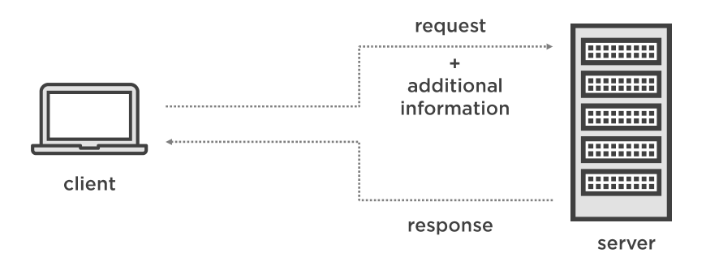
Data Extraction – API

Slide 9
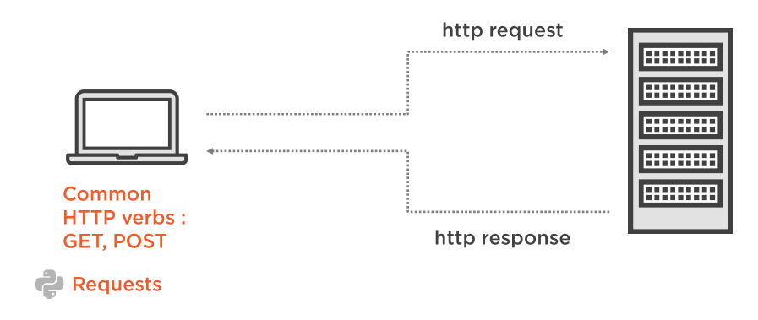
Data Extraction – REST API

Slide 10
Data Extraction - API
Steps to access API
Sample Code
Import the package
Use get function to make get request
Status code
Header information
Response text
Response encoding

Slide 11
Data Extraction - API
Demo

Slide 12

Data Extraction – Web Scraping
Web Page
Document Object Model (DOM)
<! DOCTYPE HTML>
<html >
<head> ... </ head>
<body>
<div class =”col -md -6">
</ div>
</ body>
</ html >

Slide 13
Data Extraction – Web Scrapping
Demo

Slide 14
Data Extraction - API
Getting Titanic Dataset - Demo

Slide 15
Data Extraction – Public Datasets
https://www.data.gov/
https://registry.opendata.aws/
https://github.com/awesomedata/awesome-public-datasets
https://github.com/awesomedata/awesome-public-datasets

